Slide 1
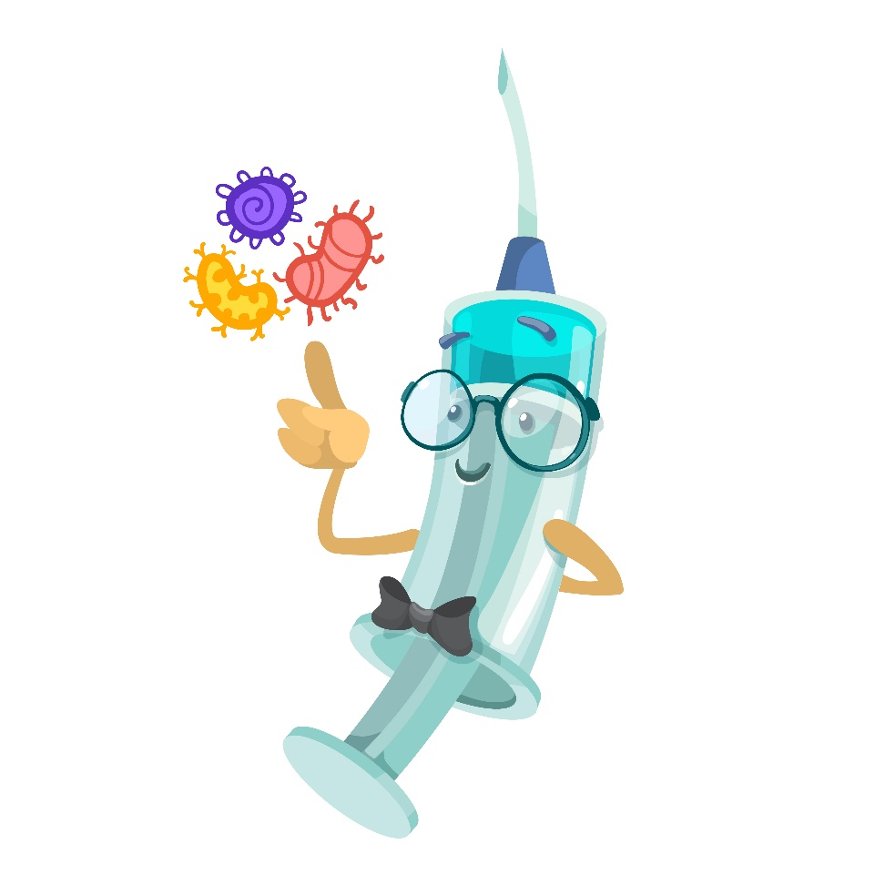

Give it a Shot!
All about vaccines
Notes:
Welcome to our workshop all about vaccines. You are going to do a few different activities today and you will find out how vaccination works.

Slide 2
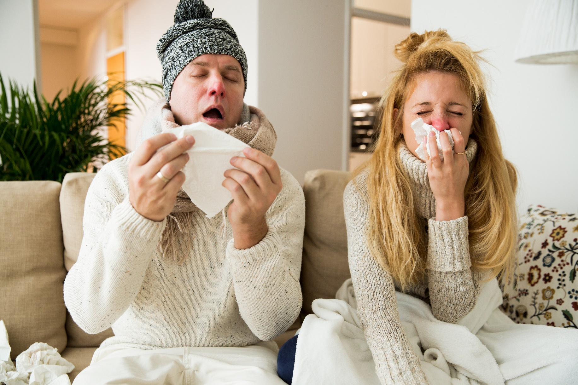
How do we catch diseases?
Notes:
Firstly – how do we catch diseases? Who has had a cold before ? How do you think you caught it?
Also consider discussing bacteria and viruses (what causes you to be ill?) and you might also move into talking briefly about how you can prevent catching/ passing on diseases (hand-washing, covering your mouth and nose etc.)

Slide 3
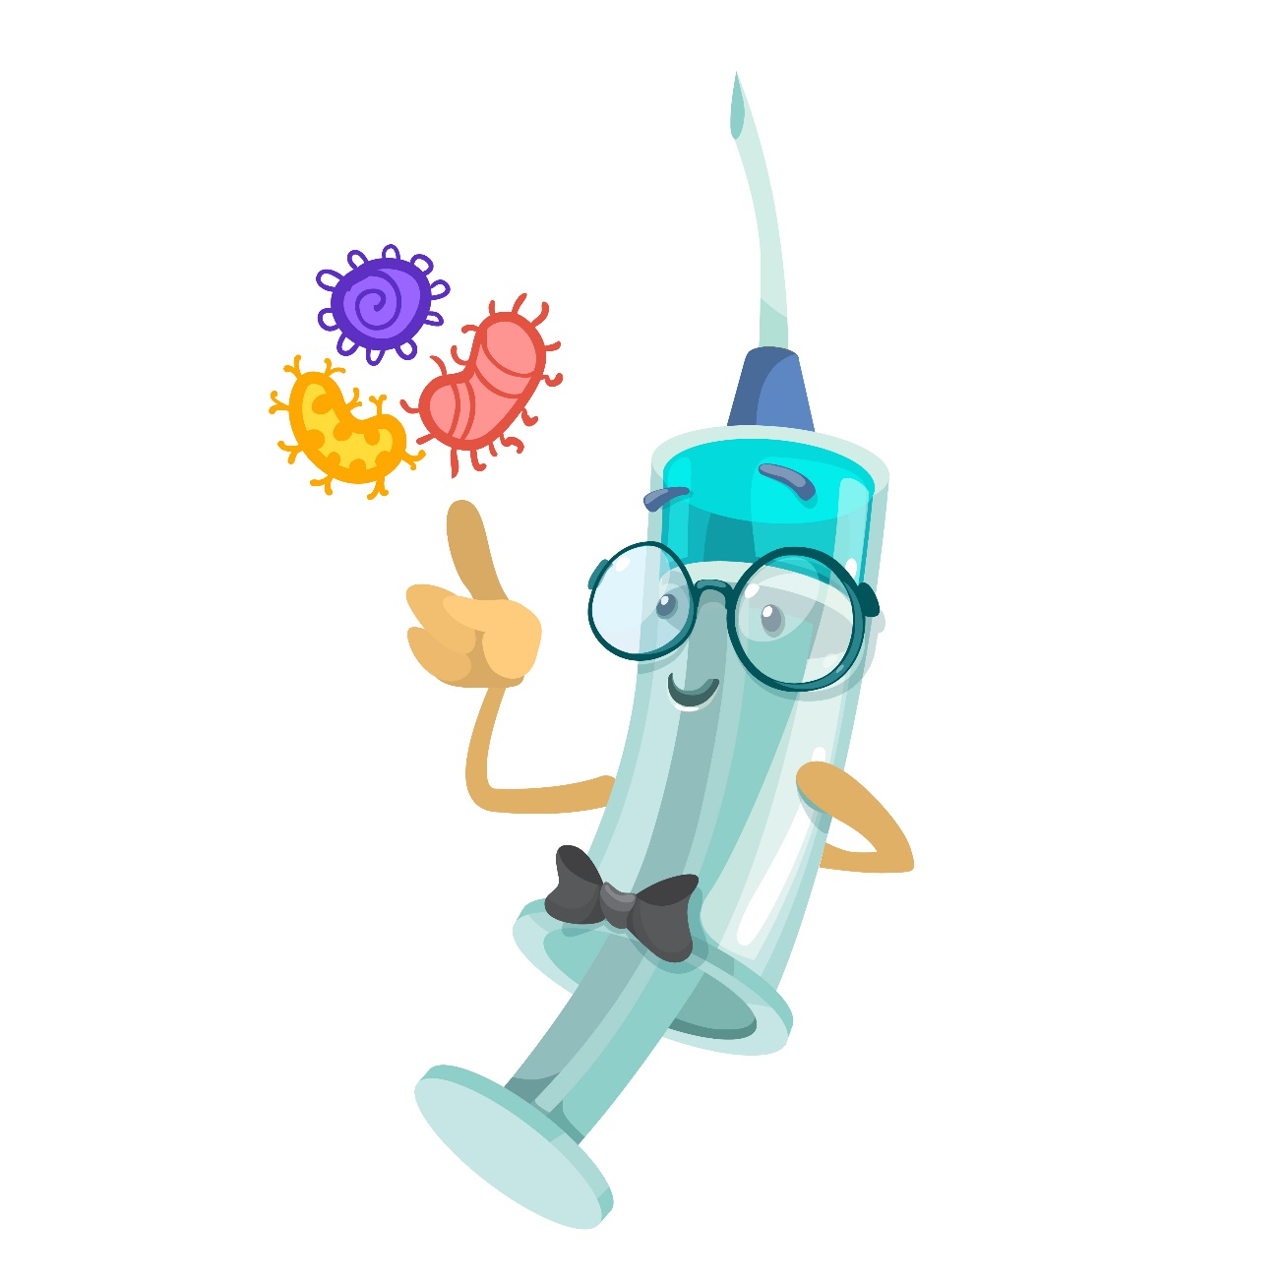
What is a vaccine?
Notes:
Ask the group: Who has heard of vaccines? Who thinks they have been given a vaccine? How did you get given the vaccine? Can you name any diseases that you’ve been vaccinated against?

Slide 4
The MMR vaccine is an example of a vaccine given to children
Measles
Mumps
Rubella
Notes:
The MMR vaccine is an example of a vaccine given to children. Who has heard of measles mumps and rubella? Do you know what happens if you catch these diseases?

Slide 5
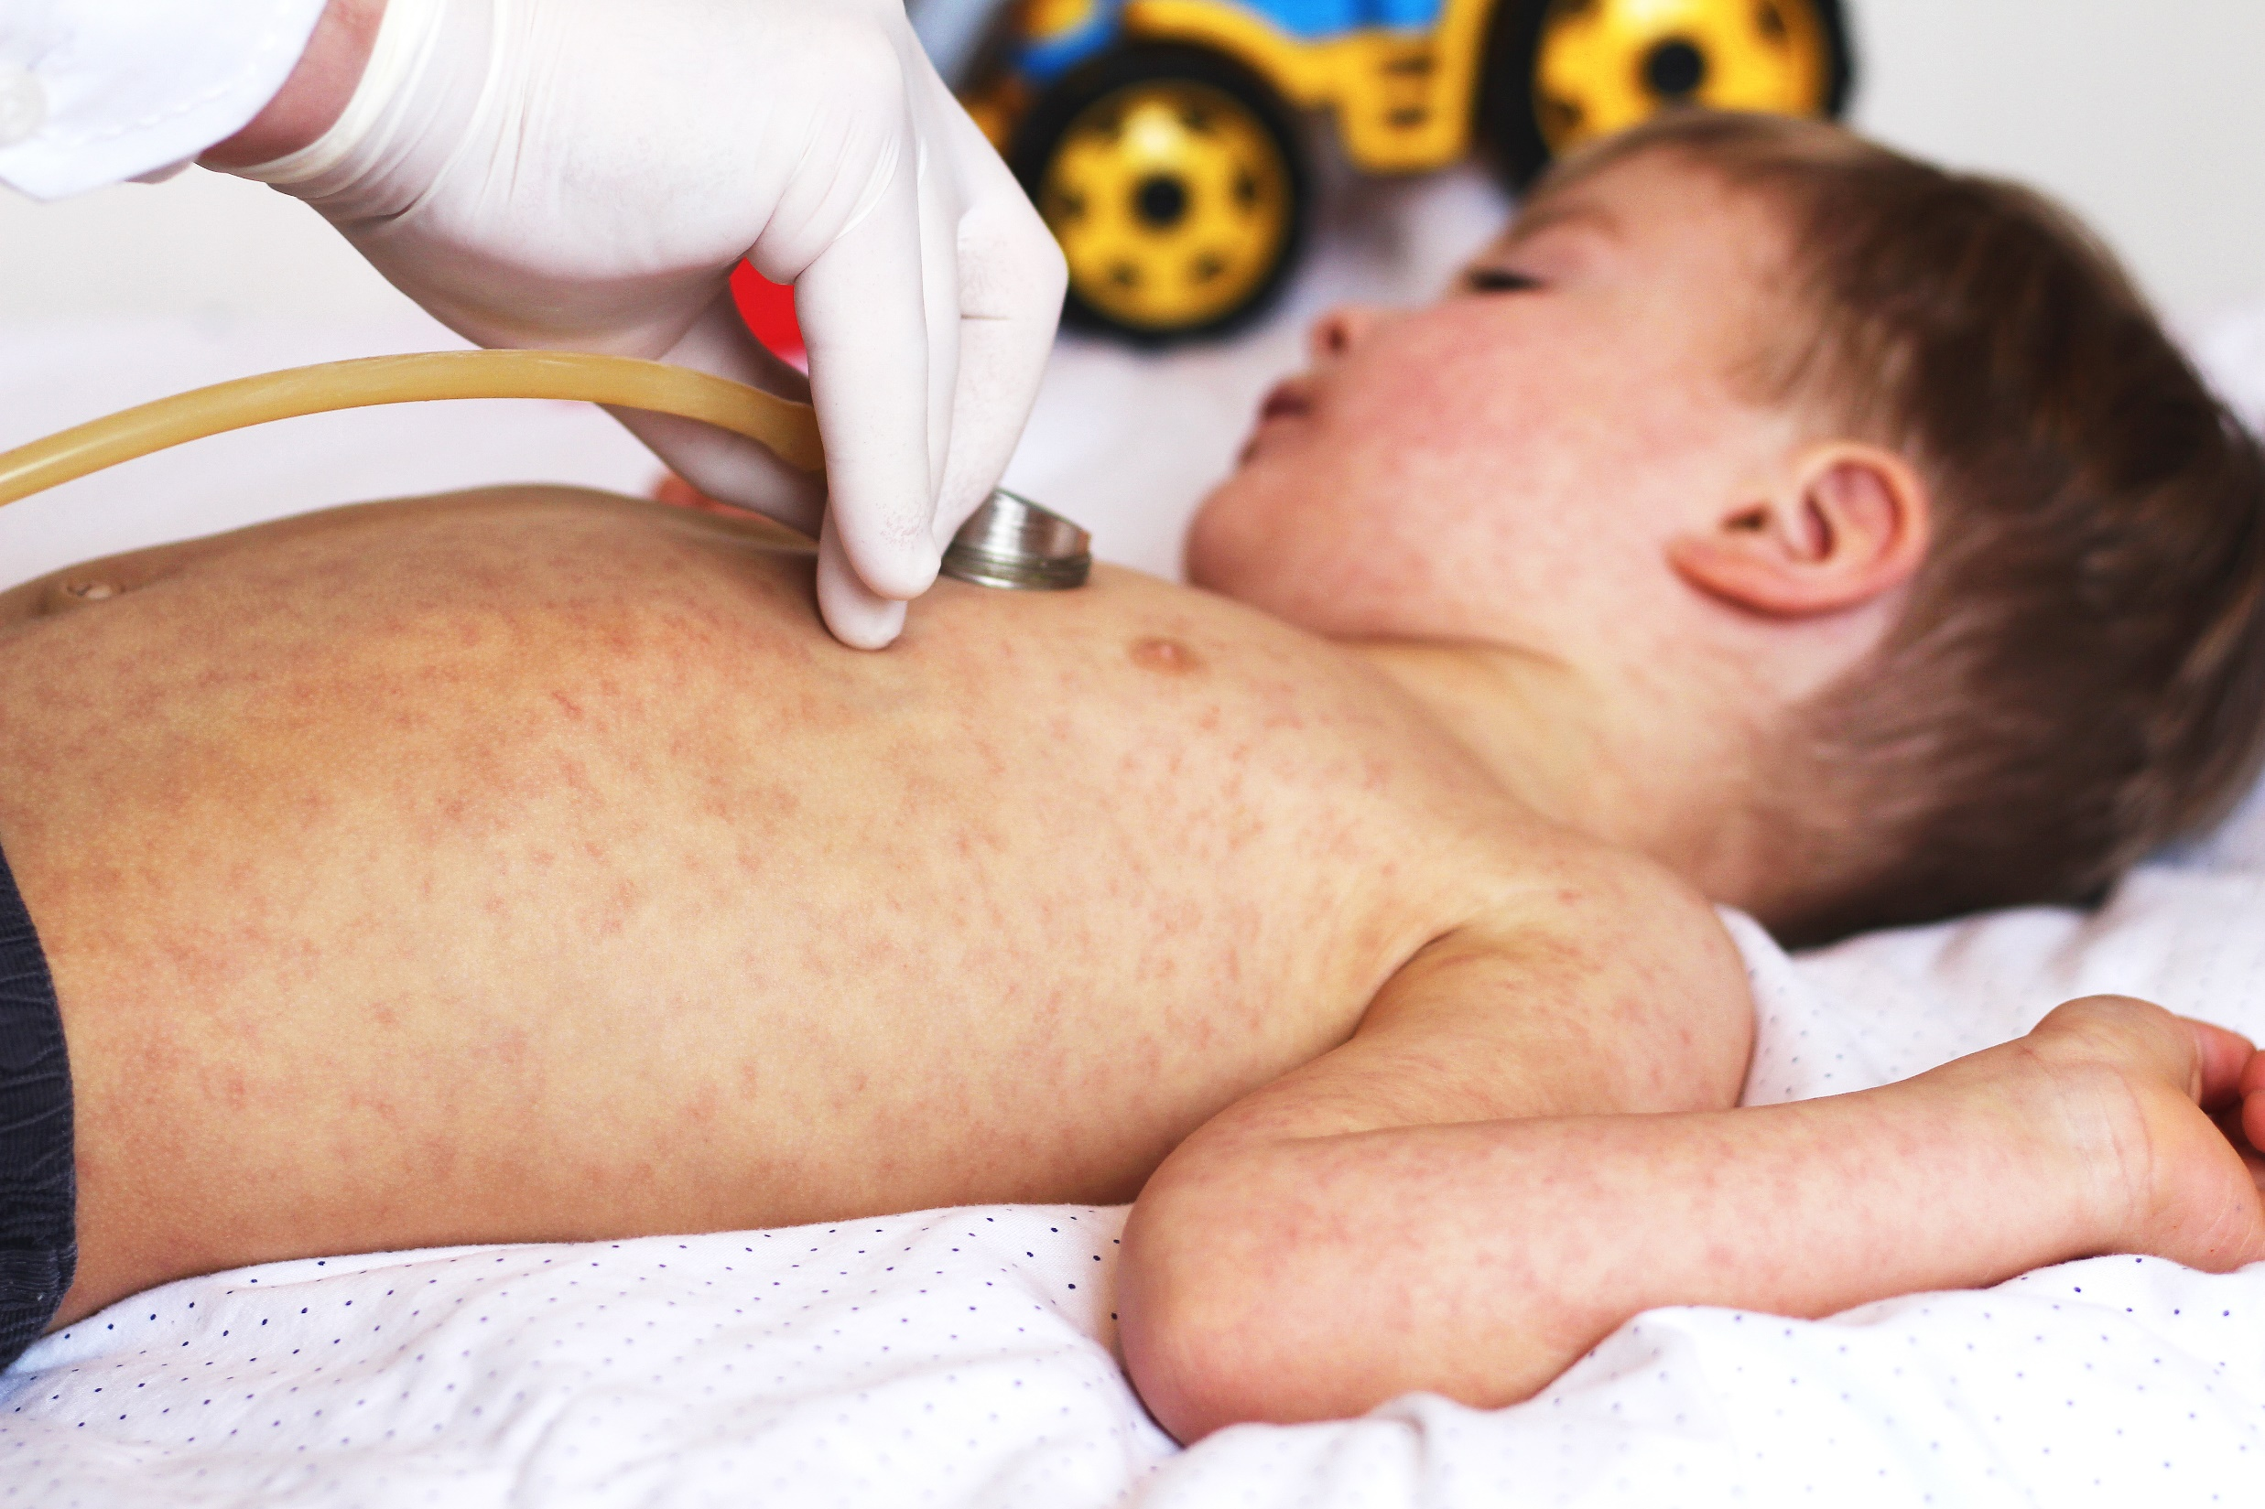
Measles
Itchy rash
Fever
Sore eyes and throat
Spots inside the mouth
Sometimes:
Fits, pneumonia, inflammation of the brain…and death
Notes:
If you get measles these are the symptoms:
Itchy rash
Fever
Sore eyes and throat
Spots inside the mouth
In a few cases people with measles also suffer with:
Fits, pneumonia, inflammation of the brain…and some unfortunately die.

Slide 6
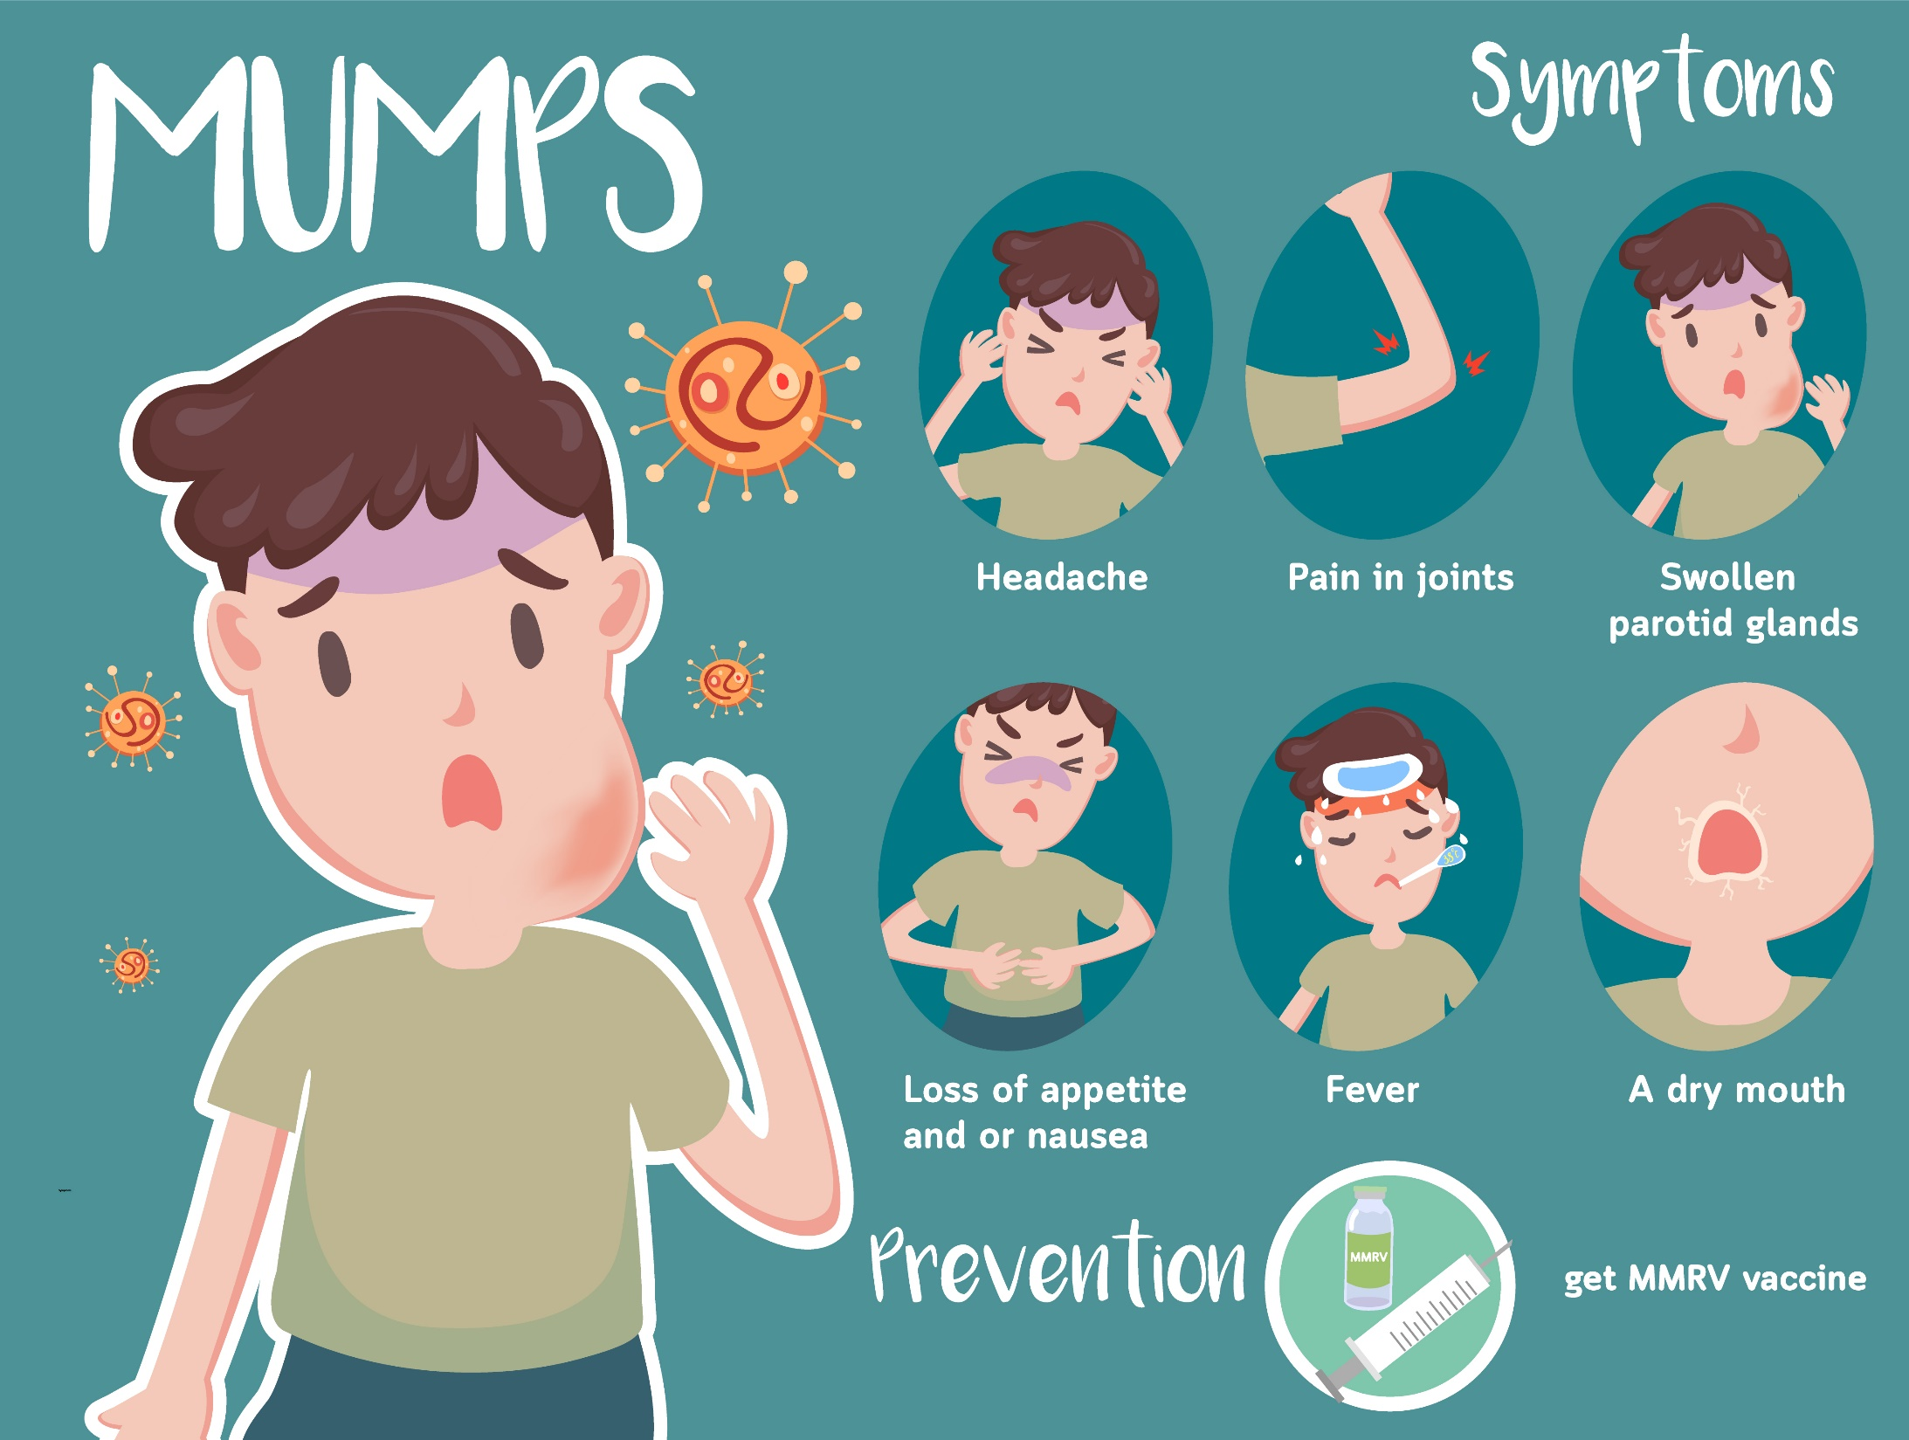
Notes:
If you have mumps you have very swollen glands in your neck. You also get a headache, aches in your joints, a dry mouth, a fever and loss of appetite.

Slide 7
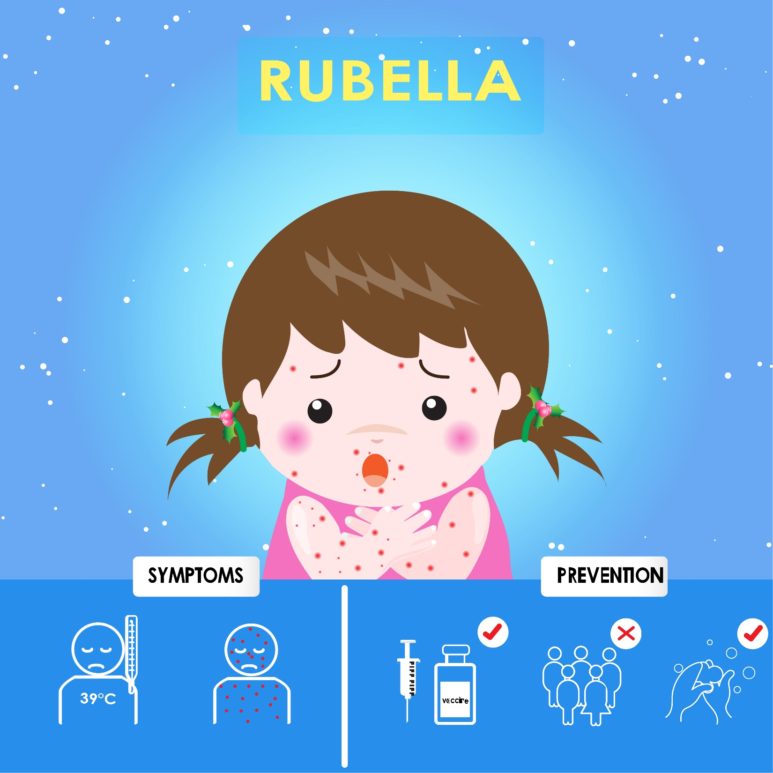
Notes:
Rubella is also very unpleasant. The main symptoms are a rash and a fever.

Slide 8
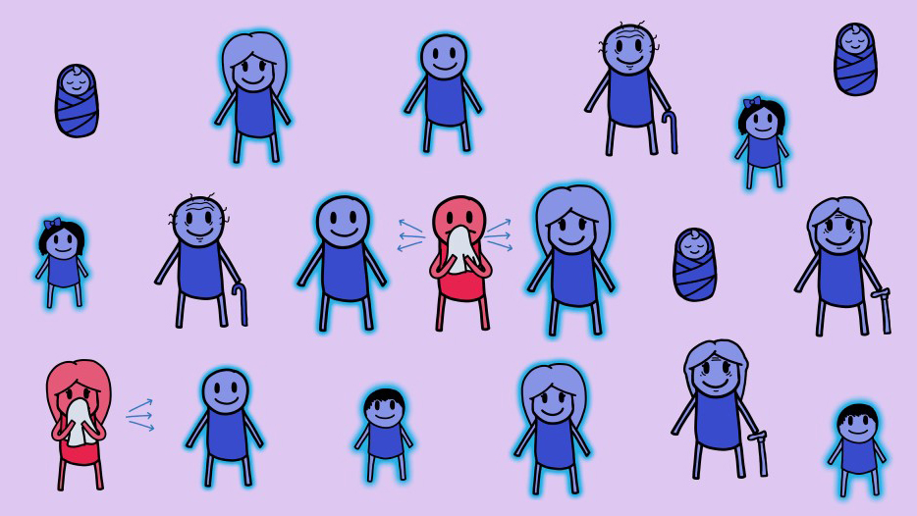
What is herd immunity? - ANIMATION
Notes:
Now we are going to watch a short animation about how vaccines work to protect people living in communities against diseases like measles, mumps and rubella, before we move into practical activities.

Slide 9
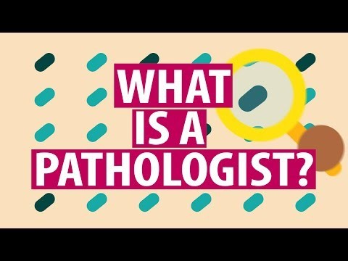
Notes:
Optional slide to show at the end of the workshop if time. Doctors that study disease and find out what is wrong with people and tell other doctors how to treat them are called pathologists. Some pathologists can be scientists. Pathologists generally work in hospitals in laboratories and are some are involved in making new vaccines against diseases. Here is a short animation about what pathologists do.
https://www.youtube.com/watch?time_continue=1&v=gtF82brtP1w

