Slide 1
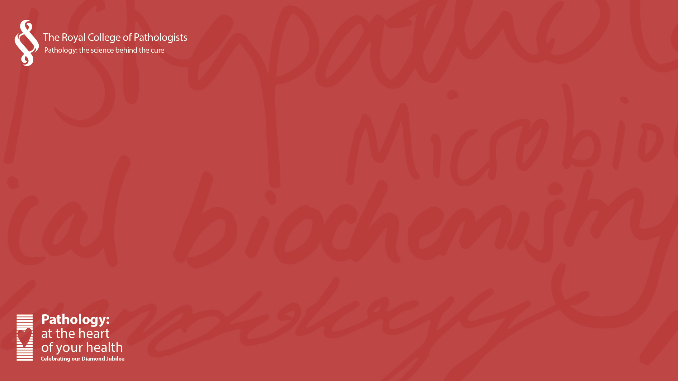


Totally Stem-azing Cells

Slide 2

About the Royal College of Pathologists
Professional membership organisation with charitable status
11,000+ members in the UK and internationally – they are pathologists and scientists working in 17 pathology specialties
Most RCPath members work in hospitals and universities in the UK
We oversee training, exams and professional standards
We also tell the public about pathology and inspire the next generation.
Notes:
About RCPath
Professional membership organisation with charitable status
Our 11,000+ members are pathologists and scientists working in 17 pathology specialties
Most RCPath members work in hospitals and universities in the UK
We oversee training, exams and professional standards
We also tell the public about pathology and inspire the next generation.

Slide 3
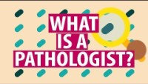
What is a pathologist?

Slide 4
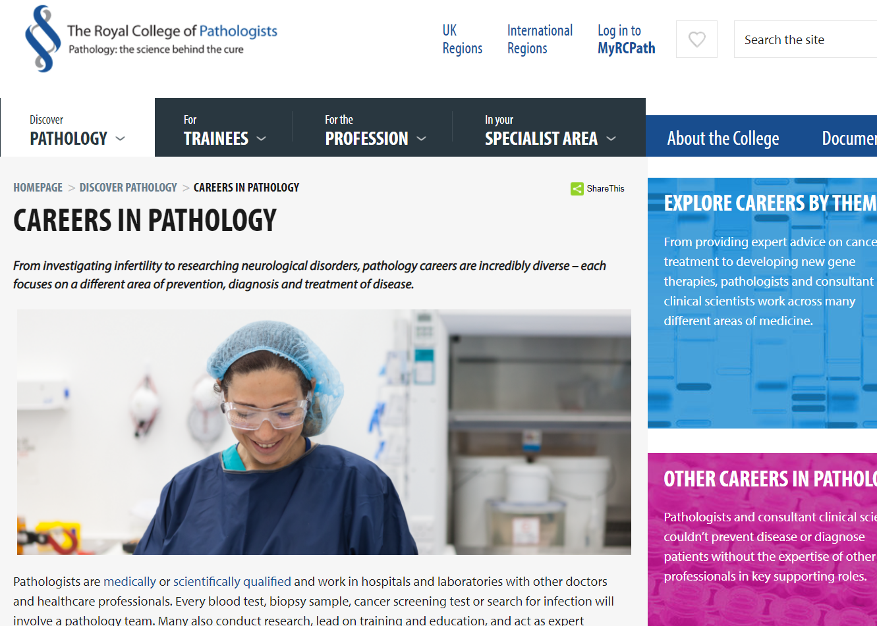




Find out more
ilovepathology
royalcollegeofpathologists
@RCPath
The Royal College of Pathologists
www.rcpath.org/careers

Slide 5
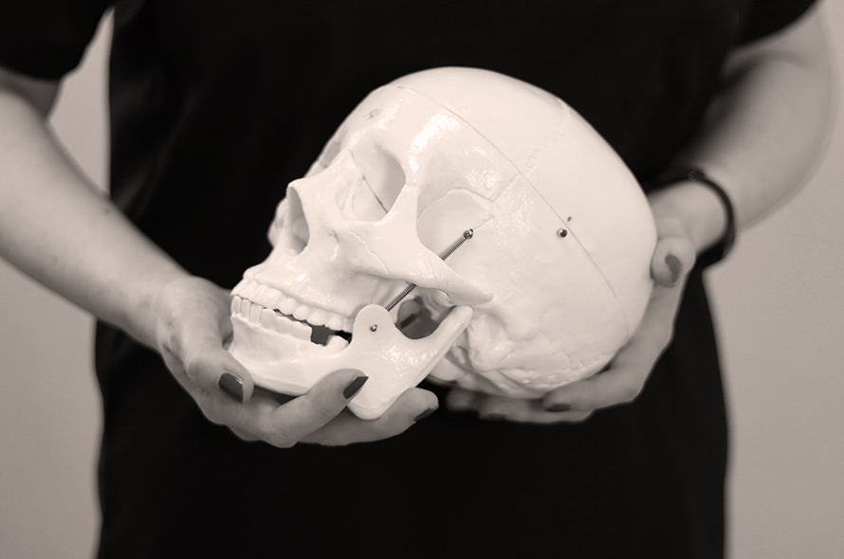
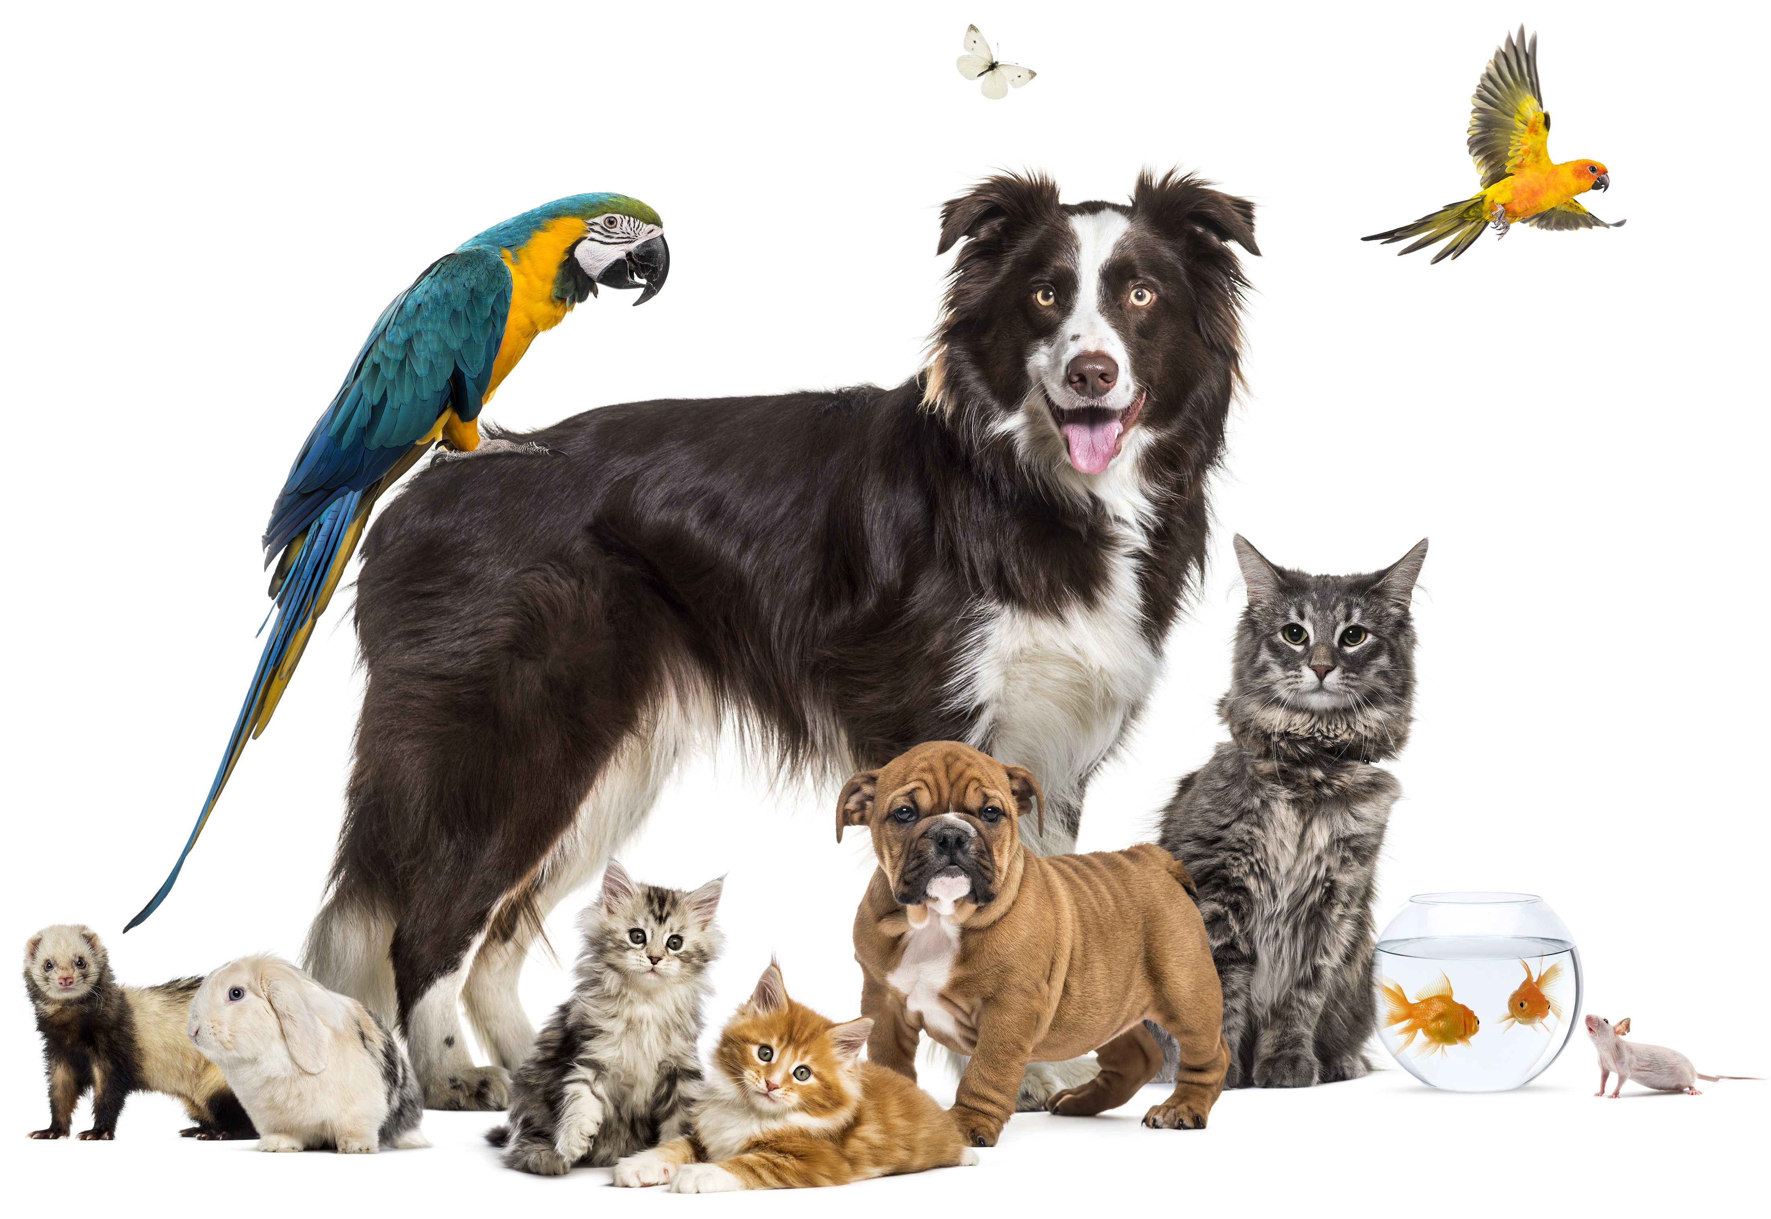
This year is our 60th anniversary!
Living Autopsy Tour Pet Portrait Competition
www.rcpath.org/diamondjubilee

Slide 6
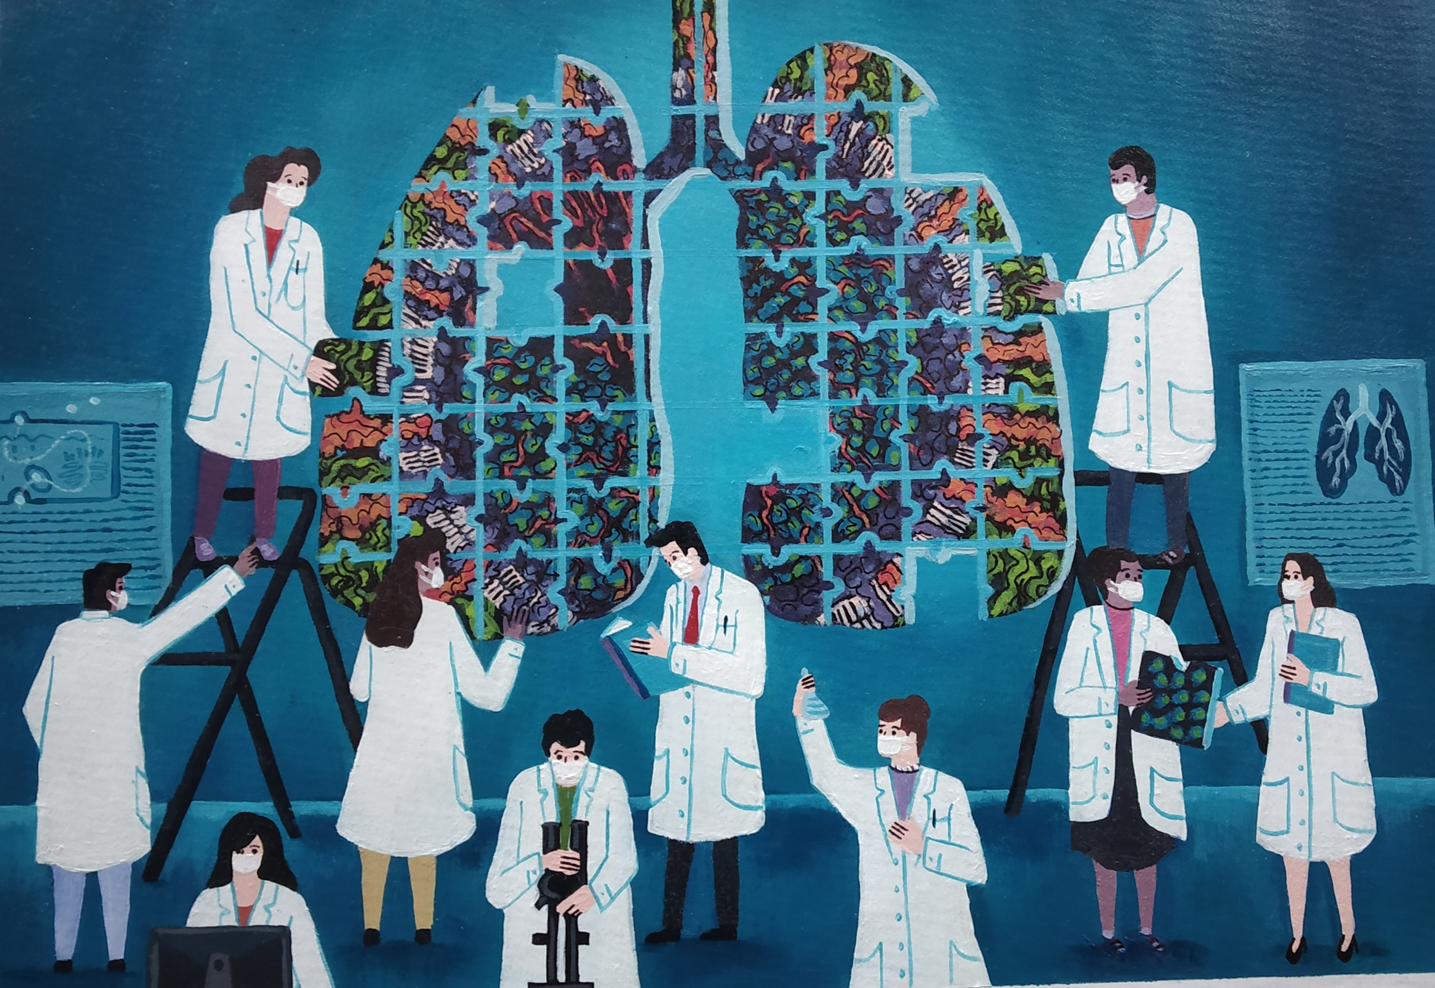
Art of Pathology Competition
Open to adults and children in the UK and abroad
This year’s theme is ‘Pathology: past, present and future’
Closes on Monday 30 May
You could win up to £1000!
Find out more at www.rcpath.org/artofpathology

Slide 7

Save the date: 20-26 June 2022
www.rcpath.org/pathologyweek

Slide 8
Introduction to stem cells

Slide 9
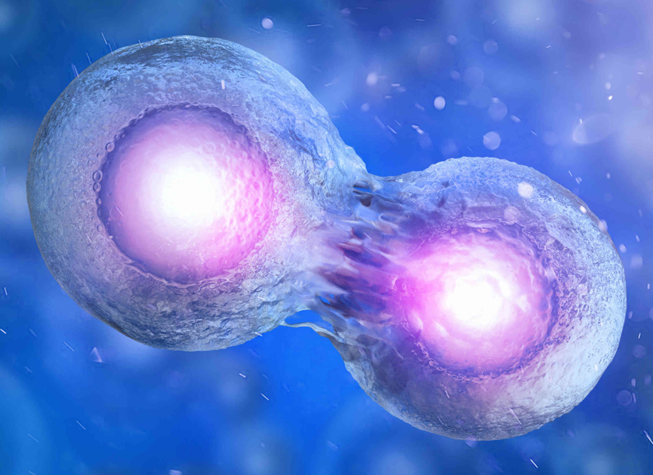
What are stem cells?
Our body is made up of many different types of cell
Most cells are specialised to perform particular functions
Stem cells are cells that are capable of cell division and specialisation into different types of cells.
Notes:
Our body is made up of many different types of cell
Most cells are specialised to perform particular functions
Stem cells are cells that are capable of cell division and specialisation into different types of cells.

Slide 10
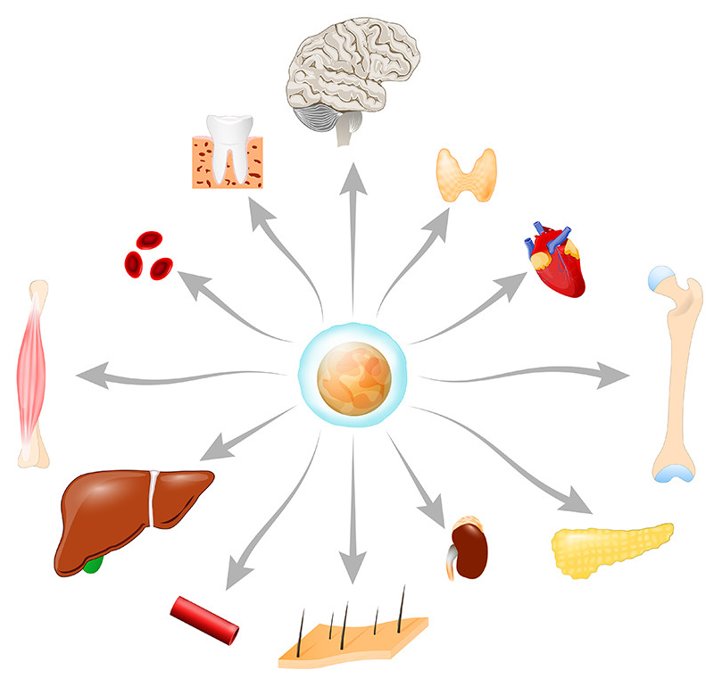
What are stem cells?
Stem cells provide new cells for the body as it grows, and replace specialised cells that are damaged or lost.
They have two unique properties that enable them to do this:
    They can divide over and over again to produce new cells.
    As they divide, they can change into the other types of cell that make up the body.
Notes:
Stem cells provide new cells for the body as it grows, and replace specialised cells that are damaged or lost.
They have two unique properties that enable them to do this:
They can divide over and over again to produce new cells.
As they divide, they can change into the other types of cell that make up the body.

Slide 11
Potential use in medical treatments
They can be transplanted into patients to treat medical conditions, replacing cells that have been damaged or destroyed.
Some disorders that can be treated using stem cells:
  Leukaemia (cancer of white blood cells)
  type 1 diabetes
  spinal cord injury
  Skin stem cells can be used to generate new skin for people with severe burns.
Notes:
Because of their unique properties, stem cells have the potential to be transplanted into patients to treat various medical conditions, replacing cells that have been damaged or destroyed.
Examples of disorders include: cancers such as leukaemia, type 1 diabetes, multiple sclerosis and spinal cord injury.

Slide 12
Activity 1:
Understanding stem cells
(10 minutes)
Notes:
You will be finding out a bit more about stem cells, where you can find them and how they are classified in the first hands on activity. You’ll have about 10 minutes to complete this first task.

Slide 14
Activity 1: round up

Slide 15
Key learning points from activity 1
What are stem cells?
  cells that are capable of cell division and specialisation into different types of cells
How are they classified?
  Stem cells are classified by their potential to differentiate
  Definitions for totipotent, pluripotent, multipotent and unipotent
Where are stem cells found?
  Zygote
  Embryonic stem cells
  Tissue-specific stem cells (also know as somatic or adult stem cells)
Notes:
Key learning points:
What are stem cells - cells that are capable of cell division and specialisation into different types of cells.
Stem cells are classified by their potential to differentiate
Definitions for totipotent, pluripotent, multipotent and unipotent
Where are stem cells found?
Embryonic stem cells
Tissue-specific stem cells (also know as somatic or adult stem cells)

Slide 16
Introducing activity 2

Slide 17
Introducing activity 2
In this next part of the workshop, we're going to be looking at how stem cells can be used to treat a disease called Fanconi anaemia.
Notes:
In this next part of the workshop, we're going to be looking at how stem cells can be used to treat a disease called Fanconi anaemia.

Slide 18
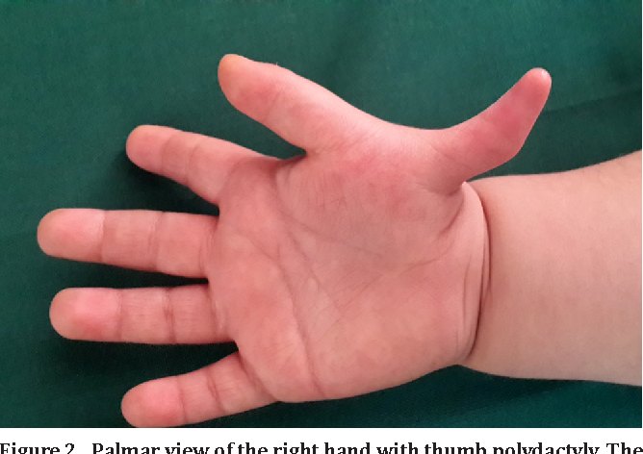
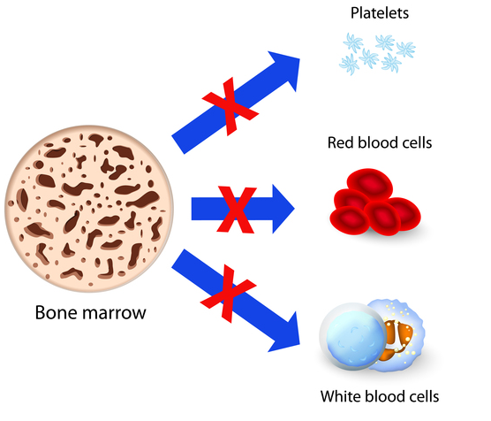
Fanconi anaemia
A genetic disorder associated with
  physical defects (for example abnormal thumbs, short height, skin problems, organ defects etc)
  bone marrow failure with anaemia (due to low red blood cells), risk of infection (due to low white blood cells) and bleeding (due to low platelets).
  Patients with FA are also at risk of developing cancers particularly acute myeloid leukaemia (AML)
Source: DOI:10.22038/ABJS.2016.4711
Notes:
Fanconi anaemia
A genetic disorder associated with
physical defects (for example abnormal thumbs, short height, skin problems, organ defects etc)
bone marrow failure with anaemia (due to low red blood cells), risk of infection (due to low white blood cells) and bleeding (due to low platelets).
Patients with FA are also at risk of developing cancers particularly acute myeloid leukaemia (AML)

Slide 19
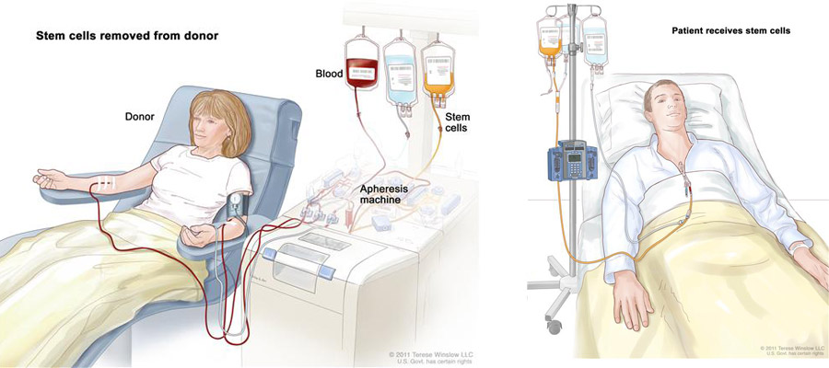
Fanconi anaemia – is there a cure?
Haematopoietic stem cell transplantation (HSCT) is the only curative treatment option for the blood problems seen in Fanconi anaemia.
Notes:
Fanconi anaemia – is there a cure?
Hematopoietic stem cell transplantation (HSCT) is the only curative treatment option for the blood problems seen in Fanconi anaemia.
This treatment replaces stem cells from another healthy person (known as a donor).

Slide 20
Who can the donor be?
Stem cells can be donated from someone else (a donor) who has the matching tissue type (HLA type) collected from blood or from bone marrow.
The donor can be:
A family member
  Even if the patient has a brother or sister then there is less than a 30% chance that they will be a tissue match to allow them to be the donor
Notes:
Who can the donor be?
Stem cells can be donated from someone else (a donor) who has the matching tissue type (HLA type) collected from blood or from bone marrow. The donor can be:
1. A family member – Even if the patient has a brother or sister then there is less than a 30% chance that they will be a tissue match to allow them to be the donor

Slide 21
Who can the donor be?
An unrelated donor
  Anthony Nolan has a register of willing volunteers who are ready to donate their stem cells to someone in need of a transplant.
  Rare/less common HLA tissue types may be harder to find a matching donor for, because there may be fewer people with your tissue type.
  Patients are more likely to find a matching donor from someone with a similar ethnic background, because HLA tissue types are inherited
Notes:
Who can the donor be?
2. An unrelated donor. Anthony Nolan, a UK charity that works in the areas of leukaemia and hematopoietic stem cell transplantation, has a register of willing volunteers who are ready to donate their stem cells to someone in need of a transplant.
If you have an HLA tissue type that’s rare or less common, it may be harder to find a matching donor, because there may be fewer people with your tissue type.
Patients are more likely to find a matching donor from someone with a similar ethnic background because our HLA tissue types are inherited. Anthony Nolan is hard at work, both in the UK and internationally, to encourage people from minority ethnic backgrounds to join their country’s stem cell registers.

Slide 22
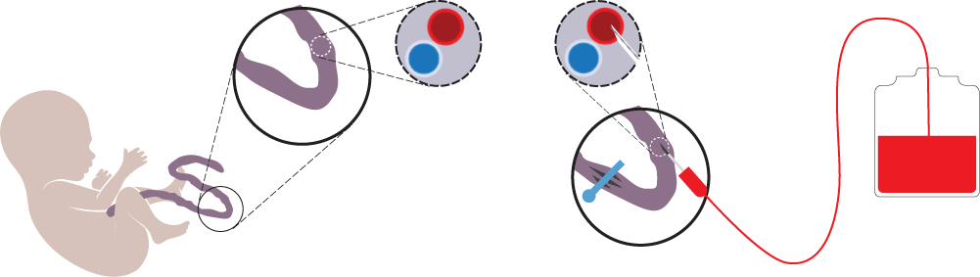
Who can the donor be?
Cord blood transplant
  Some people may be given stem cells from an umbilical cord.
  Cord blood is found in an umbilical cord which connects a baby in the womb to the placenta. The placenta and umbilical cord are a rich source of stem cells.
Notes:
Who can the donor be?
3. Some people may be given stem cells from an umbilical cord. Cord blood is found in an umbilical cord which connects a baby in the womb to the placenta. The placenta and umbilical cord are a rich source of stem cells.
A cord blood transplant can be an alternative option if a brother, sister or matched unrelated donor is not available. Stem cells found in cord blood are ‘immature’, which means they can develop to suit the patient and may not need to be an exact match.

Slide 23
What is a saviour sibling and what are the ethical issues?
The saviour sibling is conceived through in vitro fertilization.
Fertilized zygotes are tested for genetic compatibility using a process called human leukocyte antigen (HLA) typing, using preimplantation genetic diagnosis (PGD), and only zygotes that are compatible with the existing child are implanted.
Zygotes are also tested to make sure they are free of the original genetic disease.
Notes:
What is a saviour sibling and what are the ethical issues?
The saviour sibling is conceived through in vitro fertilization.
Fertilized zygotes are tested for genetic compatibility using a process called human leukocyte antigen (HLA) typing, using preimplantation genetic diagnosis (PGD), and only zygotes that are compatible with the existing child are implanted.
Zygotes are also tested to make sure they are free of the original genetic disease.

Slide 24
What is a saviour sibling and what are the ethical issues?
When the baby is born, umbilical cord blood is taken and used for hematopoietic stem cell transplantation.
Notes:
What is a saviour sibling and what are the ethical issues?
Upon birth, umbilical cord blood is taken and used for hematopoietic stem cell transplantation.

Slide 25
Activity 2:
Saviour siblings
(10 minutes)
Notes:
In the case we're considering today, Sibling A, has Fanconi anaemia. Their parents have decided that they would like to try and create a baby via IVF (sibling B) - they will select an embryo that is matched with the older sibling, so that they can help treat Sibling A.

Slide 26
Activity 2 (10 minutes)
Is it right for the parents to create a new baby using IVF to help treat their first child?
Consider the pros and cons and different points of view – for example:
The parents
Sibling A
Sibling B
Notes:
Activity 2:
Is it right for the parents to create a new baby using IVF to help treat their first child?

Slide 27
Activity 2: feedback from groups
Is it right for the parents to create a new baby using IVF to help treat their first child?
Consider the pros and cons and different points of view – for example:
The parents
Sibling A
Sibling B
Notes:
Activity 2: feedback from groups
Is it right for the parents to create a new baby using IVF to help treat their first child?
Host to go round each table and ask facilitator to summarise 1 key point from their discussion.

Slide 28
Where to find out more
www.rcpath.org/SSC2022
www.eurostemcell.org
BBC Bitesize
Notes:
Activity 2:
Is it right for the parents to create a new baby using IVF to help treat their first child?

Slide 29
Feedback and leaflets

Slide 30
Feedback post-it notes
Tell us one thing you discovered today
Any other thoughts about today’s workshop?

Slide 31
Thank you!
Any questions?

Slide 32
Totally Stem-azing Cells

