Slide 1
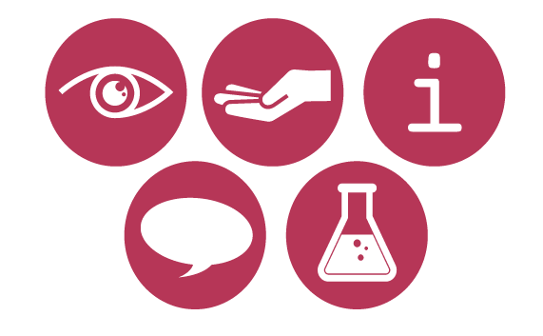

URINE TROUBLE
URINE RESOURCE

Slide 2
RED URINE
Red urine can be a sign of bladder cancer.
Many tumours have an extensive supply of blood vessels. These small vessels can rupture and blood can leak into the urine, changing the colour.
Kidney stones can cause bleeding in the kidney, which can turn your urine red.
Any injury to the kidneys, where your urine is produced, can cause bleeding and this blood will tint your urine.

Slide 3
RED URINE COULD ALSO MEAN…
Eating too much beetroot can turn your urine red.
Beetroot contains a red pigment, betacyanin (a member of the betalain group of compounds), which can be excreted in your urine.
If you get kicked hard in the back, when playing sports, sometimes your bladder lining bleeds, making your urine red.

Slide 4
CLEAR URINE
One in 25,000 people suffers from diabetes,
which makes their urine clear.
Diabetics often need to urinate more, as their kidneys are working harder to cope with the high sugar concentration in the blood. More water comes out of their tissues into the bloodstream, and this excess water is excreted. The more water, the more dilute the urine is.
If you’re on diuretic drugs for high blood pressure,
your urine can be clear.
Such drugs make your body excrete more water.

Slide 5
CLEAR URINE COULD ALSO MEAN…
Drinking lots of water can make your urine clear.
Urobilin, a by-product of bile breakdown (bile being the substance, produced in the liver, that breaks down fats in our digestive system), is what tints our urine yellow. The more we drink, the more water is excreted, diluting the urobilin pigment.

Slide 6
DARK YELLOW URINE
If you’ve taken Vitamin B and C over the recommended daily intake, they will pass through into your urine, making it bright yellow.
Vitamins B and C are water-soluble, and taking in too much means the excess will be excreted in the urine, turning it a brighter yellow colour.
Not drinking enough water can lead to your urine being dark yellow or orange.
Dehydration means your body will retain water rather than excrete it, leaving your urine more concentrated.

Slide 7
DARK YELLOW
URINE COULD ALSO MEAN…
Eating carrots can turn your urine dark yellow. Almost orange!
The yellow-orange pigment carotene can be excreted in your urine too, changing the colour of your urine.
Eating too many salty foods can make your urine orange.
Excess sodium in the blood leads to retention of water, so your urine will be more concentrated.

Slide 8
PINK URINE
This can happen through your bladder lining bleeding when taking part in high-energy sports such as running, tennis, boxing or being kicked hard in the back.
Any injury to the bladder lining, where your urine is stored, can cause bleeding and this blood will tint your urine.

Slide 9
PINK URINE COULD ALSO MEAN…
Eating blackberries can turn your urine pinkish-red.
Blackberries contains a red pigment, a betalain similar to that found in beetroot, which can be excreted in your urine.

Slide 10
GREEN URINE
Cystitis, caused by the bacteria Pseudomonas aeruginosa, can turn your urine green.
Bacteria can produce pigmented byproducts causing the colour change of your urine.
Some chemicals called phenols (used to treat Parkinson’s disease and present in some antidepressants) can turn your urine light green.
The excreted drug causes the colour change of your urine.

Slide 11
GREEN URINE COULD ALSO MEAN…
Eating asparagus can turn your urine green.
Pigments such as anthocyanins (blue-green) and various sulphuric compounds broken down when digesting asparagus, can enter your urine. (You could also discuss the pungent, sulphur-like smells: but is this odour because some of us can smell it whereas others cannot? Genetic differences).

Slide 12
MILKY/CLOUDY URINE
Cloudy urine can be a sign of a bacterial infection.
Any bacterial infection that gets into the urinary system, will be defended by the body’s immune system and some white blood cells will be released into the urine, changing the appearance of your urine.

Slide 13
MILKY/CLOUDY
URINE COULD ALSO MEAN…
Eating lots of phosphate-rich foods (milk, cheese and liver) can turn your urine milky.
Crystals of phosphorus and calcium can accumulate in the body and as these are excreted, can cause a milky appearance of your urine.

