Slide 1

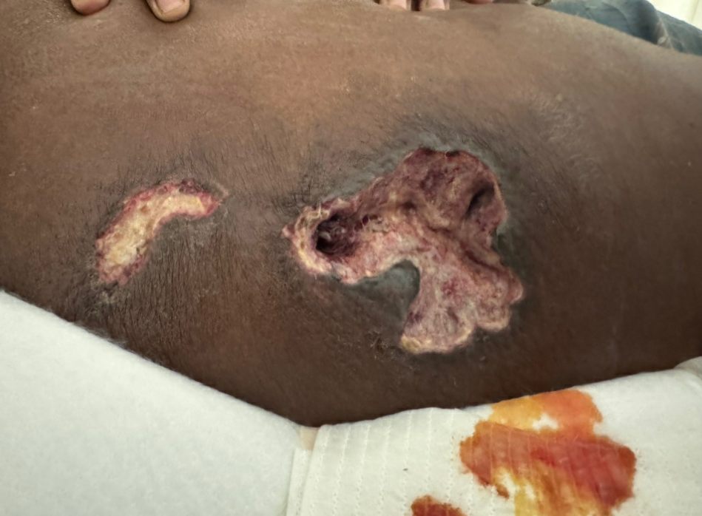
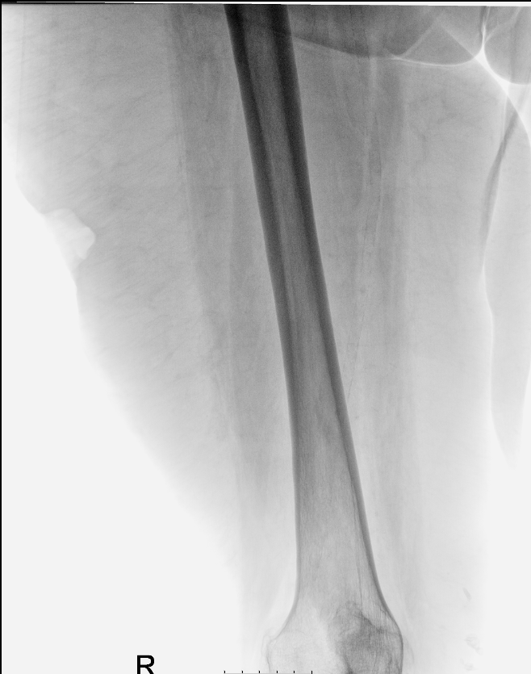
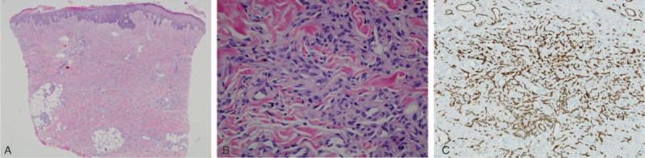
Case Report: Diffuse Dermal Angiomatosis
Dr. Fatma Shahin, Dr. Rana Goadar
Background:
Diffuse dermal angiomatosis is rare, benign, chronic reactive vascular proliferation.
Clinically is usually present with livedoid erythematous–violaceous plaques that turn to ulceration and necrosis.
Histologically it ‘s characterized with diffuse proliferation of endothelial cells within the full thickness of the dermis.
Presentation:
61-year-old lady presented to the dermatology clinic in January 2025 with an ulcerating lesion on the right thigh. She reported the lesion started as scab like lesion in November 2024. Treatment with antibiotics was done by GP.
Examination: skin type V. A lesion observed (fig. 1) on the lateral side of the right thigh measuring 15 x 20 mm with a central area of infection or ulceration.
Past medical history: T2DM, RA, HTN, Hypercholesterolaemia, MI - previous stent , left ventricular apical thrombus.
Primary differentials were drug induced ulcer and panniculitis.
Management: Deep incisional biopsy was taken and treatment with local antibiotic and emollient started.
Figure 1
Imaging:
XR done (fig. 2)showing no bone involvement but soft tissue loss at the ulcer site
Histopathology results:
The primary histopathology report showed ulcerated squamous epithelium parakeratosis and mild acanthosis. Dermis showed acute on top of chronic inflammation with blood vessel proliferation. Endothelial cells were mildly pleomorphic with no severe cytological atypia.
The report was not conclusive, and the case was sent for specialist opinion.
Their histopathological finding were very similar , agreeing in the less likely diagnosis of malignancy (namely angiosarcoma) and more likely diagnosis of diffuse dermal angiomatosis, which is regarded as a variant of reactive angioendotheliomatosis. This variant occurs in skin in conditions associated with ischaemia, mainly in scenarios such as gross obesity, in which pendulous skin creates conditions ripe for ischaemia.
(fig 3 shows histopathological findings. Source in the reference)
Figure 2
Management plan:
Vascular team was consulted but they explained this a small vessel disease that wouldn’t be managed by the vascular team.
Dermatology team plan: for regular dressing, dermovate ointment and GTN spray to the edges of the ulcer, good control of the BP and glucose levels, consider referral to the weight loss/ bariatric clinic .
Figure 3
(A) Diffuse proliferation of endothelial cells involving the full dermal thickness, HE 40×. (B) Endothelial cells interstitially arranged between the collagen bundles, HE 100×. (C) The specimen was positive for CD34, stain at 200×. CD34 = cluster of differentiation 34, HE = hematoxylin and eosin
Conclusion and learning points:
Diffuse dermal angiomatosis can represent a diagnostic challenge to the treating team and hence impacting the management and life of the patient.
Skin biopsy and histopathological examination was the key element of diagnosis in this this case. This aided to create a long-term and ongoing care plan for the patient to ensure better management and outcome.
Reference and source of the histological photo:
García-Colmenero, L., Martin-Ezquerra, G., Gómez-Martín, I., Mellado Joan, M., Barranco, C., Albero-González, R., Villar-García, J., & Pujol, R. M. (2016). Persistent cutaneous abdominal ulcerations secondary to diffuse dermal angiomatosis: an underestimated sign for severe atherosclerosis: A case report. Medicine, 95(29), e4212. https://doi.org/10.1097/MD.0000000000004212

